Slide 1
CSC 334 – Parallel and Distributed Computing
Instructor: Ms. Muntha Amjad
Lecture# 06: Parallel Sorting

Slide 2
Sorting in Parallel
Why?
  It is a frequent operation in many applications
Goal?
  Sorting a sequence of values in increasing order using n processors

Slide 3
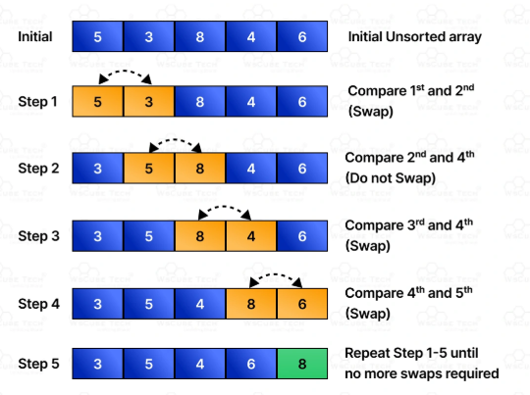
Bubble Sort
Idea: Given a list of n elements, repeat the following steps n -1 times:
  For each pair of adjacent numbers, if number on the left is greater than the number on the right, swap them.
  “Bubble” the largest element to the end of the array using pair-wise comparisons and swapping.

Slide 4
Bubble Sort
BUBBLE-SORT(A)
n ← length[A]
for i ← 0 to n – 2
for j ← 0 to n – i – 2
if A[ j ] > A[ j+1 ]
A[ j ] ↔ A[ j+1 ]
Time complexity is O(N²) independent of the order of the elements.

Slide 5
Parallel Bubble Sort: Odd-Even Sort
Idea: Rearrange the comparisons in as many independent comparisons as possible!
Observation: Comparisons can be carried out in parallel if every processor is involved in at most one compare-and-exchange.
This can be achieved if the processors are grouped into even/odd pairs or odd/even pairs
  Odd–Even Phase: The odd processes p compare and exchange their elements with the even processors p + 1
  Even–Odd Phase: The even processes compare and exchange their elements with the odd processors p + 1

Slide 6
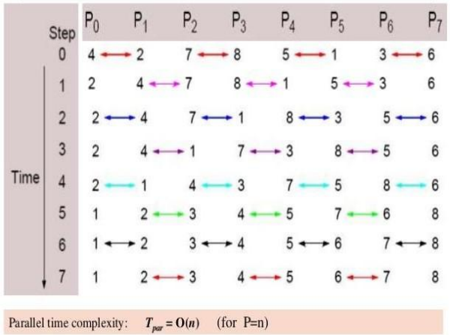
Odd-Even Sort
4 | 2 | 7 | 8 | 5 | 1 | 3 | 6
4 | 2 | 7 | 8 | 5 | 1 | 3 | 6
2 | 4 | 7 | 8 | 1 | 5 | 3 | 6
2 | 4 | 7 | 8 | 1 | 5 | 3 | 6
2 | 4 | 7 | 1 | 8 | 3 | 5 | 6
2 | 4 | 7 | 1 | 8 | 3 | 5 | 6
2 | 4 | 1 | 7 | 3 | 8 | 5 | 6
2 | 4 | 1 | 7 | 3 | 8 | 5 | 6
2 | 1 | 4 | 3 | 7 | 5 | 8 | 6
2 | 1 | 4 | 3 | 7 | 5 | 8 | 6
1 | 2 | 3 | 4 | 5 | 7 | 6 | 8
1 | 2 | 3 | 4 | 5 | 7 | 6 | 8
1 | 2 | 3 | 4 | 5 | 6 | 7 | 8

Slide 7
Odd-Even Sort
OddEvenSort(A)
n = length[A]
for (i = 0; i <= n - 1; i++)
if( i%2 == 0)
#pragma omp parallel for
for (j = 0; j <= n - 2; i+=2)
if A[j] > A[j+1]
A[j] ↔ A[j+1]
else
#pragma omp parallel for
for (j = 1; j <= n - 2; i+=2)
if A[j] > A[j+1]
A[j] ↔ A[j+1]
barrier();

Slide 8
Odd-Even Sort
Assuming array size n and p threads
  (assuming p ≤ n/2, i.e., each processor handles multiple comparisons)
For each phase (odd and even)
  Comparisons ➔ n/2
  Comparisons per thread ➔ n/(2p)
Time per phase = O(n/p)
Number of phases = O(n)
Total time = O(n²/p)
Theoretical speedup ➔ O(p) linear with p for small p
  But due to synchronization overhead (barriers), actual speedup is less than ideal.

Slide 9
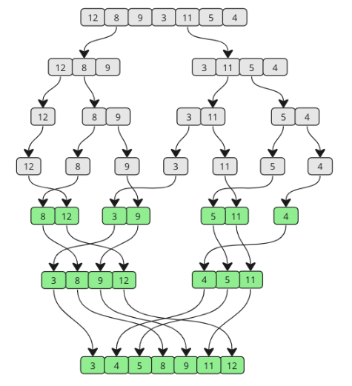
Merge Sort
Idea: Recursively divide a given unsorted list of n elements until each sub list contains one element. Then these sub lists are repeatedly merged to form a sorted list.

Slide 10


Merge Sort
MERGE-SORT(A, left, right)
if left < right
mid = $\left\lfloor (left+right)/2\right\rfloor$
MERGE-SORT(A, left, mid)
MERGE-SORT(A, mid+1, right)
MERGE (A, left, mid, right)
MERGE (A, left, mid, right)
i = left, j = mid+1, k=0
while (i $≤mid \&\& j≤$ right)
if (A[i] $≤$ A[j]
B[k++] = A[i++]
else
B[k++] = A[j++]
B[ ] = A[ ]
Time complexity is O(N lg N) independent of the order of the elements.

Slide 11
Parallel Merge Sort
Idea:
In Parallel Merge Sort, the idea is to divide the work across multiple threads, so different parts of the array can be sorted simultaneously — reducing overall time using parallel processing.

Slide 12
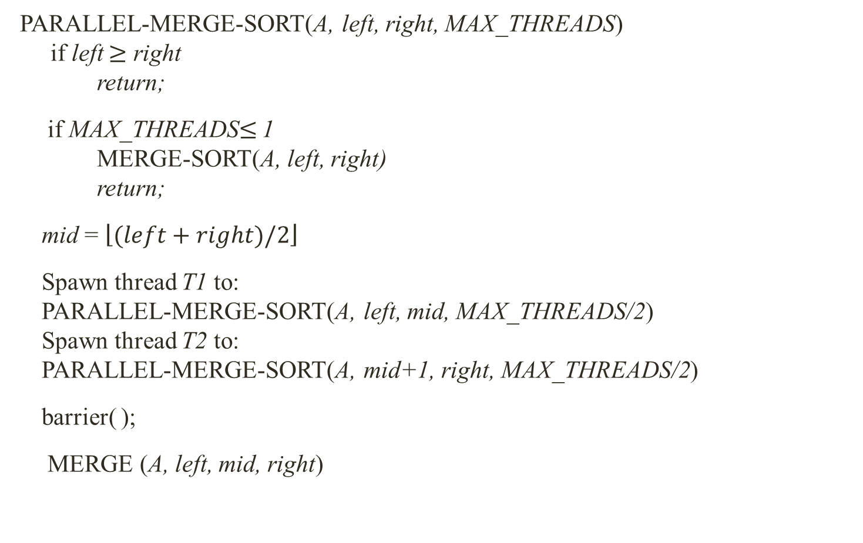

Parallel Merge Sort
PARALLEL-MERGE-SORT(A, left, right, MAX_THREADS)
if left $≥$ right
return;
if MAX_THREADS$≤$ 1
MERGE-SORT(A, left, right)
return;
mid = $\left\lfloor (left+right)/2\right\rfloor$
Spawn thread T1 to:
PARALLEL-MERGE-SORT(A, left, mid, MAX_THREADS/2)
Spawn thread T2 to:
PARALLEL-MERGE-SORT(A, mid+1, right, MAX_THREADS/2)
barrier( );
MERGE (A, left, mid, right)
MERGE (A, left, mid, right)
i = left, j = mid+1, k=0
while (i $≤mid \&\& j≤$ right)
if (A[i] $≤$ A[j]
B[k++] = A[i++]
else
B[k++] = A[j++]
B[ ] = A[ ]
Complexity: O(n lg n/p)

